Slide 1
LAB 6

Slide 2
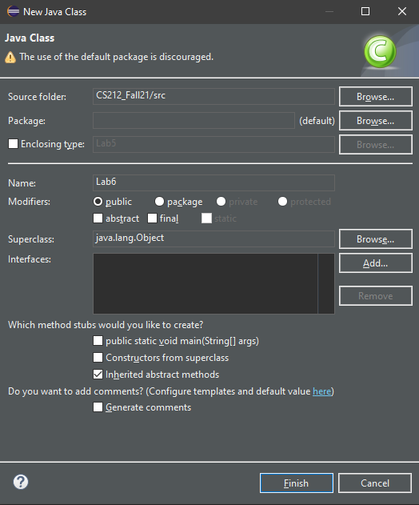
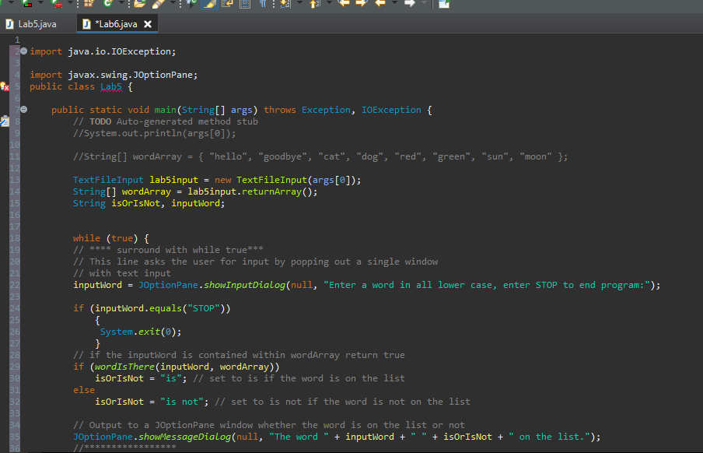
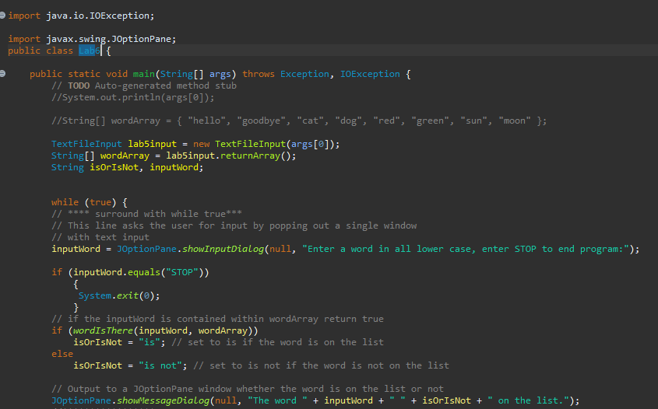
Step 1
Create a Lab6 class and copy over Lab5.java (change the line public class Lab5 to public class Lab6)
You can get rid the while true loop and its contents along with the String declarations for isOrIsNot and inputWord

Slide 3
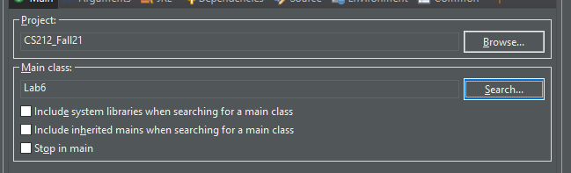
Make sure your run configurations are correct

Slide 4
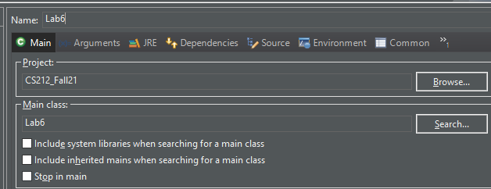
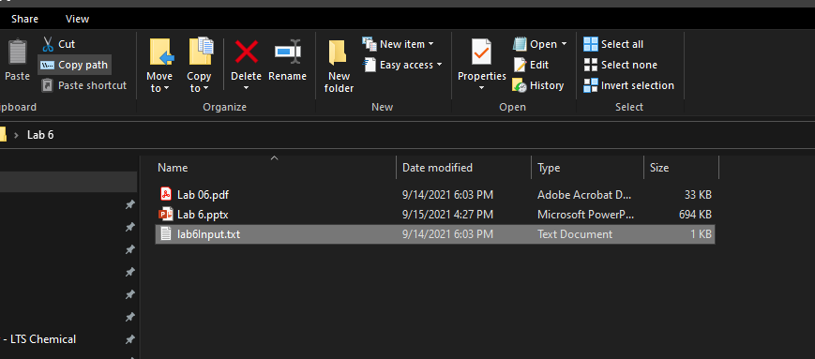
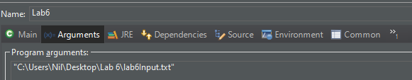
Step 1
Download lab6input.txt on to your computer and copy paste the path into the program arguments for lab6 in run configurations.
Set the main class to lab6

Slide 5
Step 1
You will want to create a method returnIntArray in InputTextFile.java by copying the code from returnArray which we used to create a String array to generate an integer array instead, this time we will pass an integer as an argument for the number of numbers in the file instead of reading the first line for the number of values to store.
Remember to change the return type of the new method to an integer array instead of a string array
Also convert each line read to an integer, and use an integer array instead of a string array within the method

Slide 6

Step 1
In the Lab6.java file you will have to change String[] wordArray to int [] intArray. (Or some other name) And assign the value returned by the returnIntArray method called your TextFileInput object, you will have to pass 14 which is the number of lines in the file we are feeding the program to generate our array
You should also delete or comment out the entirety of the while true loop and its contents, and the declarations for isOrIsNot and inputWord

Slide 7

Step 2
Write and fill in a method public static int sum (int[] myArray, int myArraySize) inside the Lab6.java file but outside the main method
You will want to loop through the array and calculate the sum of all values from the array and then return that sum at the end of the method

Slide 8
Step 2
In the main method call the method sum you just made and assign the returned value to an int, passing the int array you generated from the file and the length of the array
Use the following syntax to create a popup that will display the sum

Slide 9

Step 3
Now you want to add another method to calculate the average
public static int average (int[] myArray, int myArraySize);
You can put the code to find the sum of the values and then divide by the size or you can call the sum method within the average method and divide the returned value by the length

Slide 10
Step 3
Call the method in your main method and call a jOptionPane popup to display the average

